Slide 1
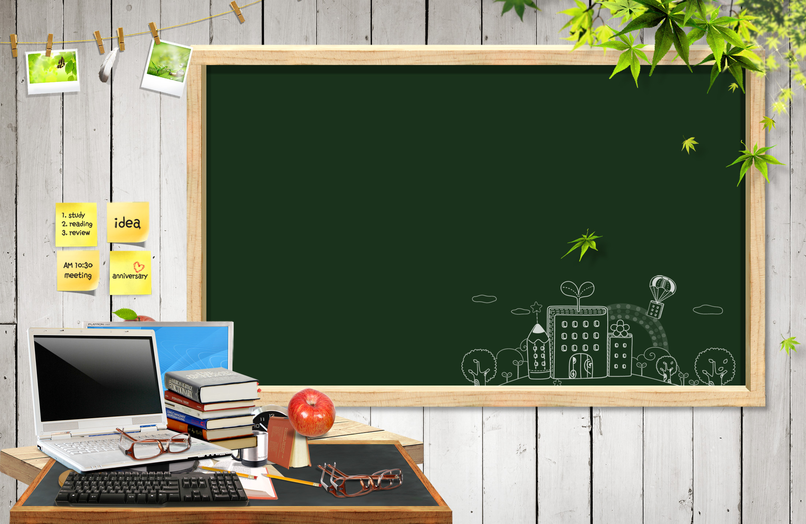
Topic for today:
FURNITURE
in the house

Slide 2
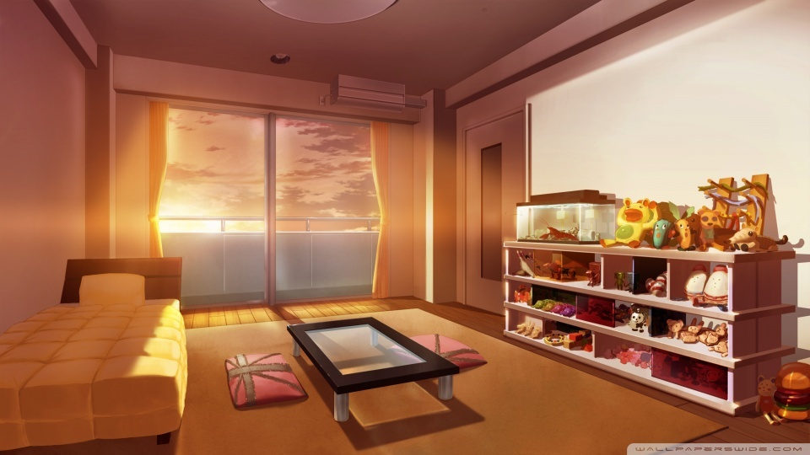
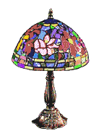
Bed room
lamp
bed
table
shelf

Slide 3
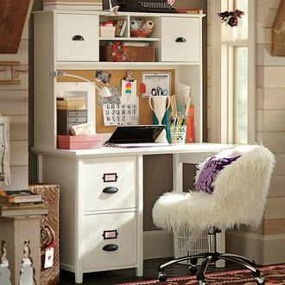
study table / desk
Do you have a
study table?

Slide 4
mirror
Do you have mirror
in your bed room?

Slide 5
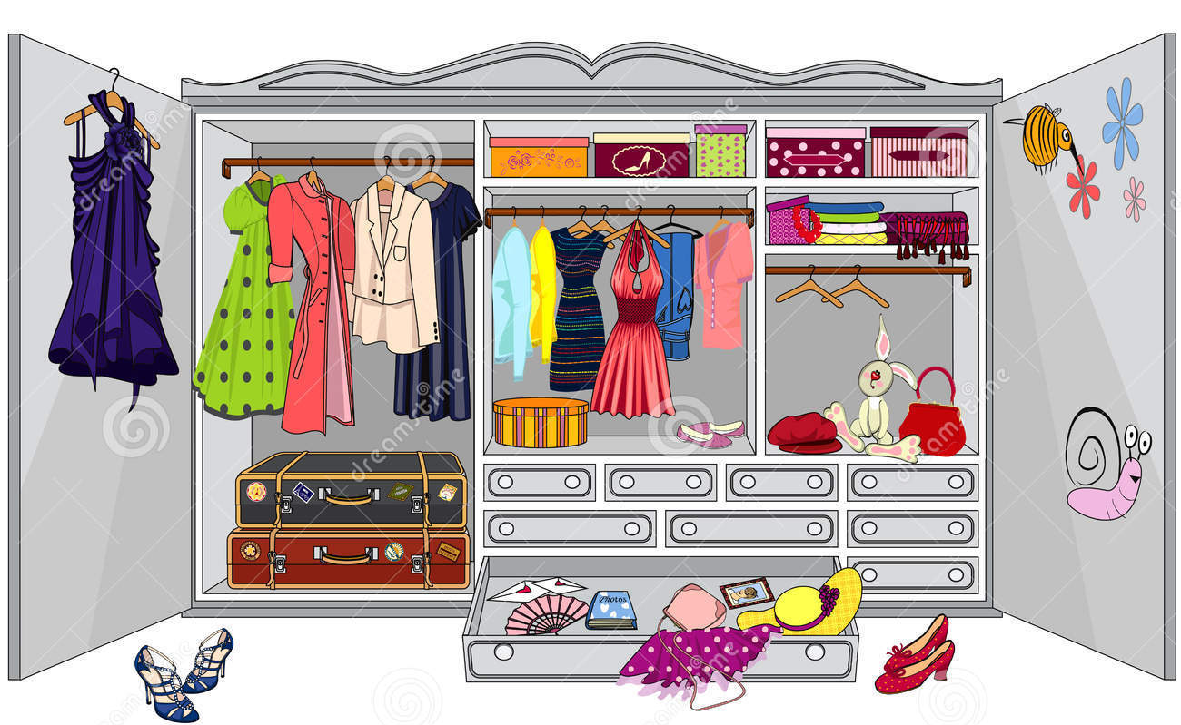
wardrobe

Slide 6
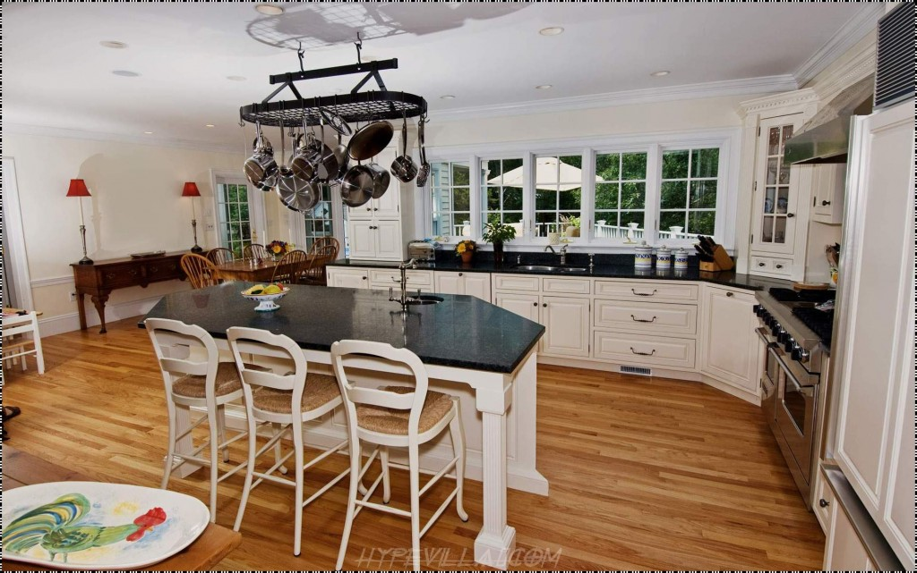
kitchen
cupboard
Dining table
stove
chair
drawers

Slide 7
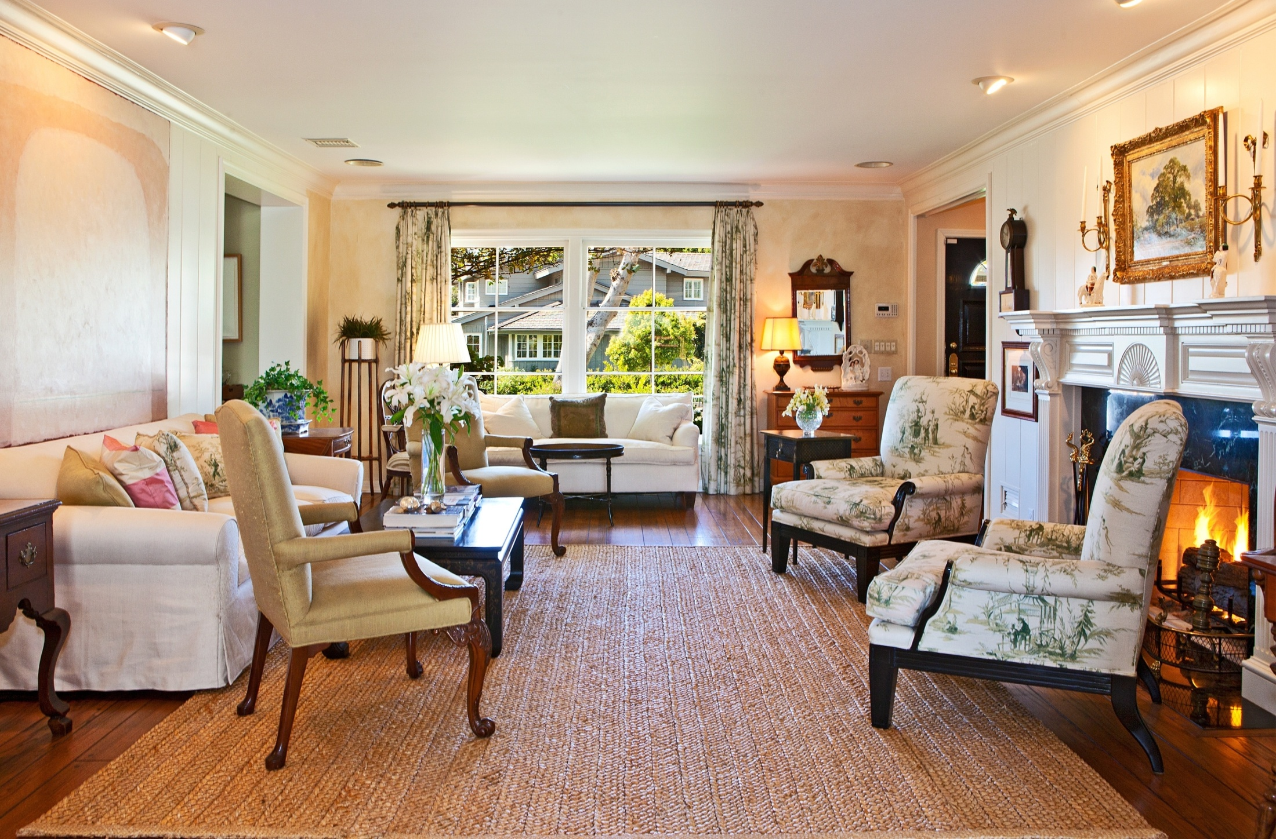
Living room
mirror
sofa
Coffee table
fireplace
table
armchair

Slide 8
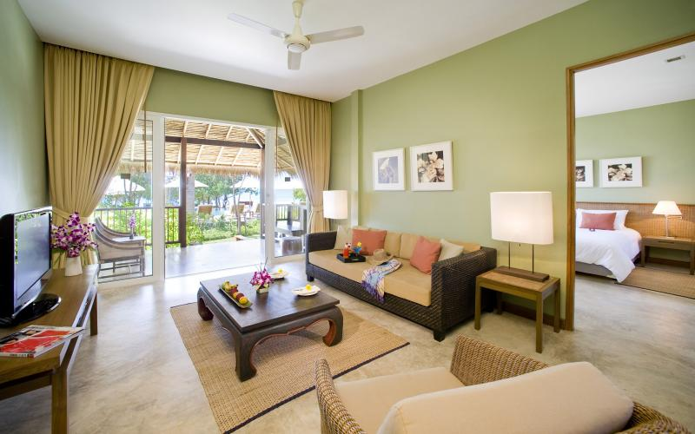
Name the furniture you see in the picture!

