Slide 1
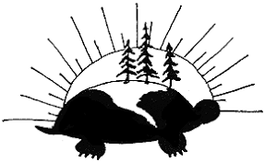
Turtle Island
Modified by P Groom from the article at CBC.ca
http://www.cbc.ca/kidscbc2/the-feed/turtle-island-wheres-that

Slide 2
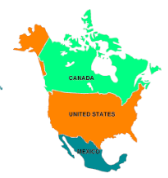
Turtle Island might sound like some far away island in the sea, but it's actually what some Indigenous people call the continent of North America, while others, such as the Ojibwa, use it to refer to the whole world.

Slide 4
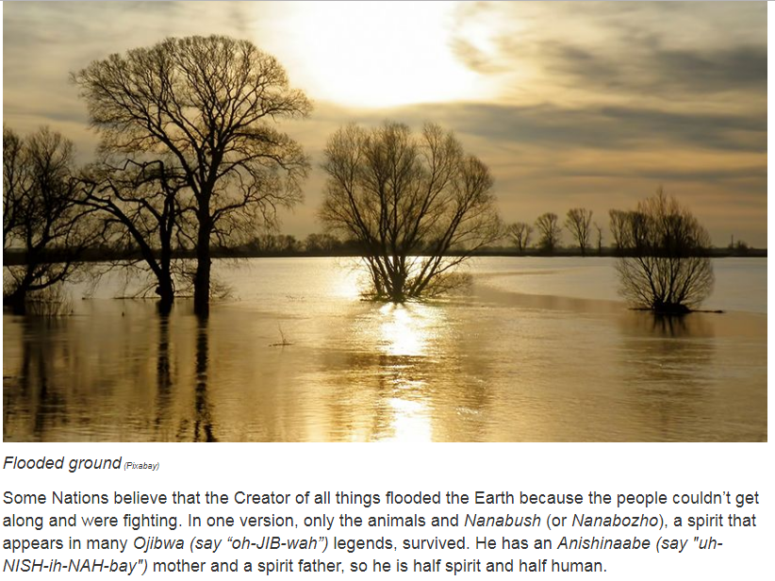
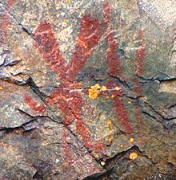
Pictogram of Nanabozho on Mazinaw Rock, Bon Echo Provincial Park, Ontario

Slide 5
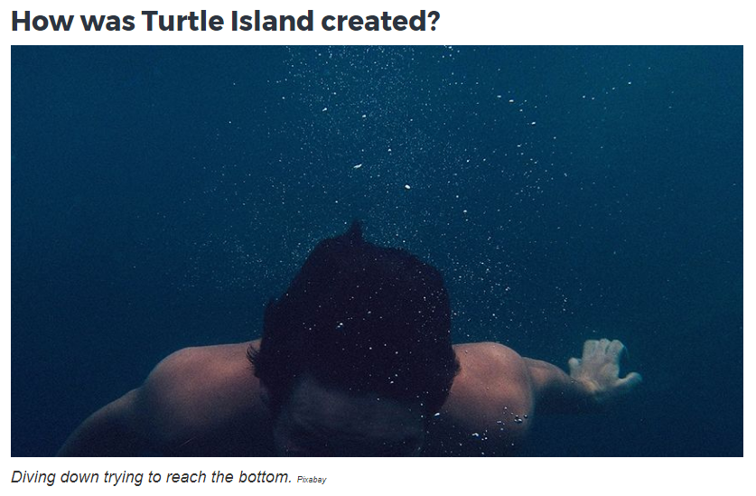

Slide 6
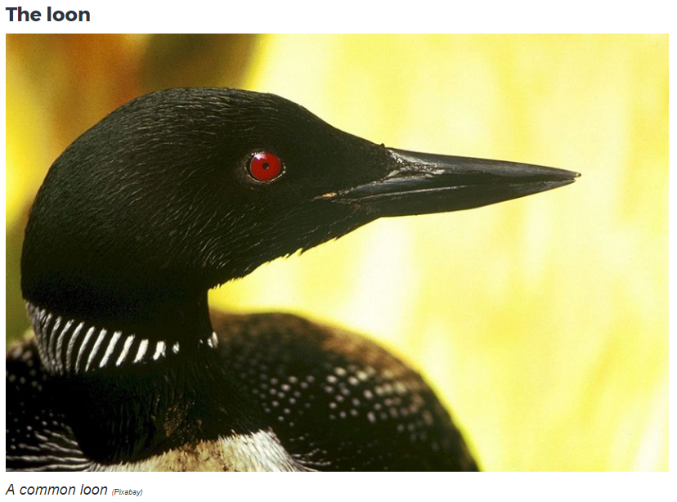

Slide 7
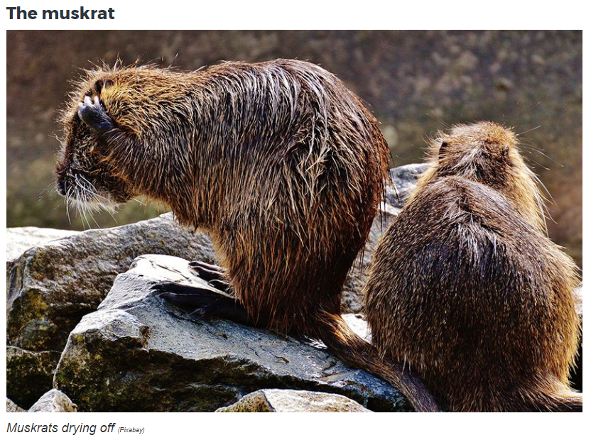
The muskrat came forward and offered to try. The other animals laughed at him because he wasn’t used to diving, but the muskrat took a deep breath and dove down into the water.

Slide 8
The other animals and Nanabush waited. They looked in the water for the muskrat, but the muskrat didn’t appear.

Slide 9
They waited a very long time and had given up when they finally saw the muskrat! They rushed to him as he breathed his last breath. As the muskrat died, they noticed that he was clutching earth that he had brought up from the water.

Slide 10
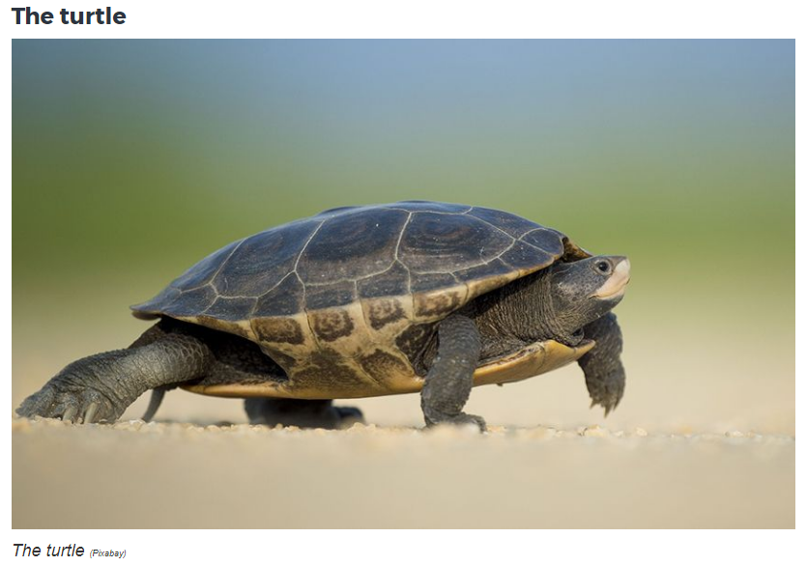
The turtle told them that if the muskrat was willing to give his life, then he could give them his shell. They could put the earth that the Muskrat had brought them on his back and he would carry it for them. The winds blew and spread the earth around. That little bit of earth that the Muskrat had brought back became Turtle Island.

Slide 11
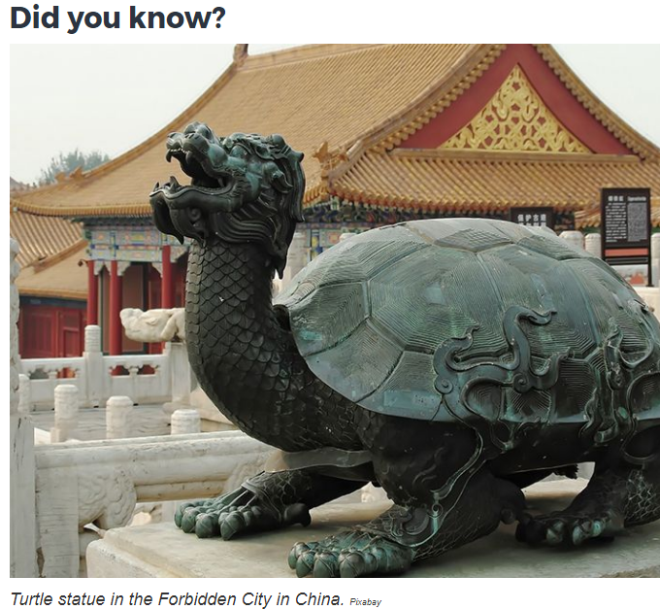
Many folktales all over the world feature a turtle! In African folklore, the turtle is the smartest animal. In Chinese mythology, the turtle is a very powerful symbol, and in Tahiti, the turtle is the lord of the oceans.

